Slide 1
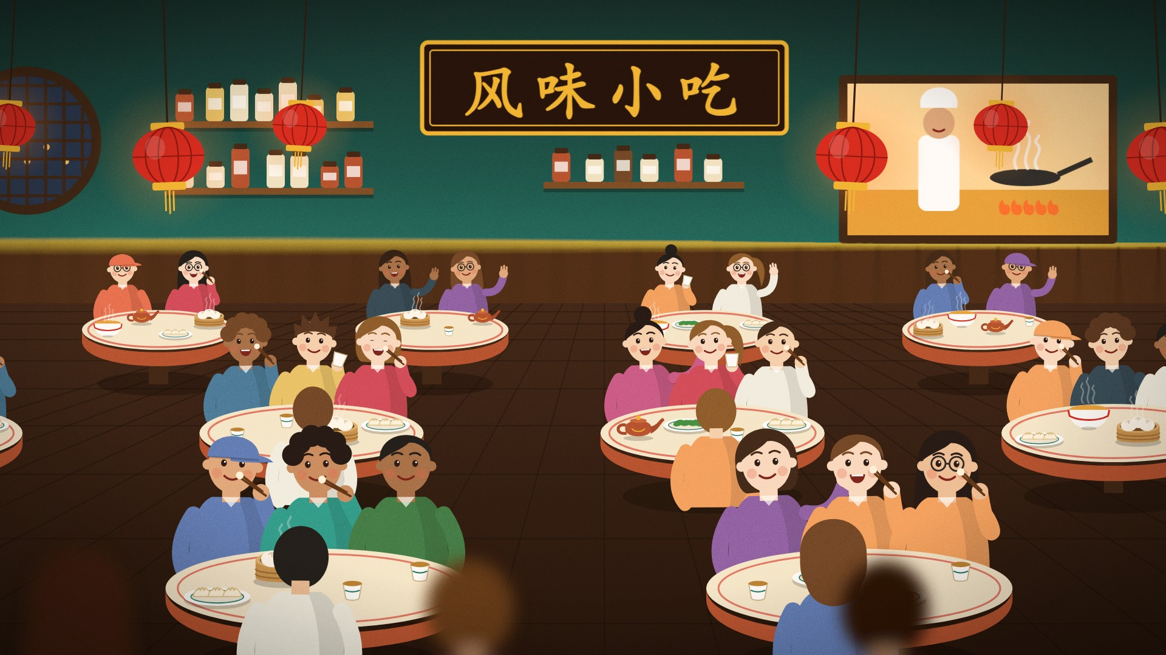

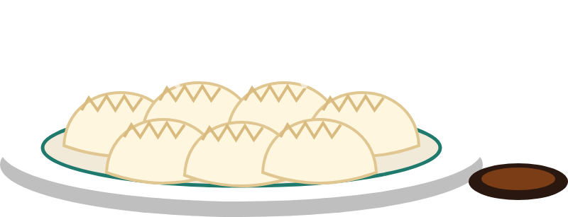

Part B: Symbolic AI
Chapters 6 to 12
What if the policy were written down where people can read, check and change it?
How software reasons from rules
Chapter 6: Introduction to Symbolic AI
On today’s menu: house-rule dumplings
IF the dough is ready AND the filling is ready THEN fold.
风味小吃 · Software and Symbolic AI · Slides V1
Notes:
TIME: about 35 s (running total under 1 min)
BEFORE THIS SLIDE:
• If this starts a new session, first recap in one sentence: “Last time, the loan policy was buried in the code, and nobody could see it without reading the program.”
READ ALOUD:
Part B is how software reasons from facts and rules that people can read, check and change.
It starts with Chapter 6. On today’s menu: house-rule dumplings. If the dough is ready and the filling is ready, then fold.
That is a rule at its simplest. So we start small, on examples from outside the library. The loan desk comes back in Chapter 9, written as rules.
SEE ALSO: Study Guide, Part B (p. 50) and Chapter 6, pp. 51–56.
READ BEFORE CLASS:
FILE PLAN: File 06 of 12, Chapter 6: Introduction to Symbolic AI. 10 slides, about 9 minutes.
GOAL: By the end, learners can say: A rule-based system can explain which conditions led to a result, but it can only use the facts and rules it has.
PREPARE: Nothing to set up. Learners vote by show of hands.
ACTIVITIES:
• Slide 3, about 1 min 25 s: A blank box, and Pip says “No pneumonia!”
• Slide 9, about 1 min 5 s: Chapter 6: last challenge
IF SHORT OF TIME: Skip the whole slide “In many products, rules work with machine learning”, and simply say that rules often work together with machine learning. On “A blank is not a no”, skip the Extension (extra facts).
IF MANY GET IT WRONG: Key check: the two votes on the blank box. If most of the room votes yes, ask whether we know that this patient has difficulty breathing, and take one more vote: yes, no, or we do not know. Then go on to the three patients.
LIKELY QUESTIONS:
• Q: Why a patient record, when the story is about a library? A: It is a small example from outside the library, so we can look at rules at their simplest. The loan desk comes back in Chapter 9, written as rules.
• Q: Ben’s answer is a real no. So can the system say “no pneumonia”? A: No. A rule that does not fire concludes nothing. The rule only says what follows when all three conditions are true.
• Q: Does a learned system, such as a spam filter, count as symbolic AI? A: No. It learned patterns from data instead of following rules written by people. That is machine learning, and Chapter 12 compares the two.
TIMES: Each time assumes speech at about 120 words a minute, the pauses written in the script and a few seconds to change the slide. Allow a little extra for settling after pair work and for questions.
CHECK: On a computer without Bahnschrift and Segoe UI, or a version of PowerPoint without Morph, the slides may look different. Use the matching PDF in PDF_copies instead, and read from Reading_Scripts, because the PDF copies carry no notes.

Slide 2

Quick recall: the umbrella rule from Chapter 1
CH
6
Symbolic AI represents knowledge explicitly with symbols, facts and rules
Also known as Good Old-Fashioned AI, or GOFAI
Facts
raining
going_outside
Rule
IF raining
AND going_outside
THEN recommend_umbrella
Result
It fires
Recommend an umbrella
A rule fires when all its conditions match the facts
风味小吃 · Software and Symbolic AI · Slides V1
Notes:
TIME: about 25 s (running total about 1 min)
READ ALOUD:
You met this rule in Chapter 1. Both conditions match the facts, so it fires.
This way of working is called symbolic AI, or Good Old-Fashioned AI: knowledge written down as symbols, facts and rules.
Now a harder case: a patient’s record.
SEE ALSO: Study Guide Chapter 6, the umbrella case.
SOURCE: chap4 slide 3.

Slide 3

A blank box, and Pip says “No pneumonia!”
CH
6
Predict first
IF fever AND cough AND difficulty breathing
THEN the patient may have pneumonia
Fever
yes
Cough
yes
Difficulty breathing
blank
“No difficulty breathing, so no pneumonia!”
Think for 30 seconds. Then vote twice.
Can the rule fire? May Pip say “no pneumonia”?
风味小吃 · Software and Symbolic AI · Slides V1
Notes:
TIME: about 1 min 25 s (running total about 2 min)
READ ALOUD:
This rule has three conditions. On this record, the difficulty breathing box is blank. And Pip announces: “No difficulty breathing, so no pneumonia!”
Two questions. Can the rule fire for this patient? May Pip conclude “no pneumonia”? Think for 30 seconds. Then we vote twice.
[Pause 30 seconds.]
First vote: can the rule fire? Hands up for yes.
[Take a show of hands.]
Second vote: may Pip conclude “no pneumonia”? Hands up for yes.
[Take a show of hands.]
Let’s compare three patients.
EXPECTED ANSWER: No to both. The rule cannot fire yet, because one condition is unknown. And a rule that does not fire concludes nothing, so it cannot support “no pneumonia”.
SEE ALSO: Study Guide Chapter 6, Pip’s problem and Predict first.
SOURCE: chap4 slide 4.

Slide 4
A blank is not a no
CH
6
Check
Fever
Cough
Breathing
Ana
yes
yes
yes
The rule fires: “may have”,
for a doctor to check
Ben
yes
yes
no
Does not fire: the rule says
nothing, not “no pneumonia”
Chen
yes
yes
blank
Cannot fire yet:
ask for the missing fact
Both votes: no. The rule cannot fire yet,
and that does not mean “no pneumonia”.
风味小吃 · Software and Symbolic AI · Slides V1
Notes:
TIME: about 1 min 5 s (running total about 4 min)
READ ALOUD:
The same rule gives three results. For Ana, it fires. The word “may” matters: it is a possible conclusion for a doctor to check, not a diagnosis.
For Ben, one condition is false, so it does not fire. Careful: the rule then says nothing at all. It does not say “no pneumonia”.
Chen’s box is blank, so that condition is unknown. The rule cannot fire yet, and a safe system asks for the missing fact.
Pip’s patient is just like Chen. So it’s no to both votes. Same with our dumplings: a blank on the order slip is not a no.
[Extension: skip if short of time.]
Extra facts, such as a headache, change nothing.
[End of extension.]
So is it ever safe to treat a blank as false?
SEE ALSO: Study Guide Figure 6.1, Activity 6.1. Test Bank M11–M12.

Slide 5
A blank counts as false only when the data is complete
CH
6
Common mistake: “If it isn’t recorded, it must be false.”
Closed-world assumption: anything not found counts as false
Safe: the data is complete
List of everyone who has paid: not on the list means not paid
Not safe: may be incomplete
A patient record with a blank: ask, or say “cannot decide”
Pip says “A blank is not a no. A blank is not a yes. A blank is a blank. I have written this on my hand.”
风味小吃 · Software and Symbolic AI · Slides V1
Notes:
TIME: about 55 s (running total about 4 min)
READ ALOUD:
Here is the common mistake. “If it isn’t recorded, it must be false.” Some rule engines really do treat anything they cannot find as false. This is the closed-world assumption.
It is safe only when the data is known to be complete, like a list of everyone who has paid. Not on the list means not paid.
A patient’s record may be incomplete. So a safe system asks, or says it cannot decide.
Pip says: “A blank is not a no. A blank is not a yes. A blank is a blank. I have written this on my hand.”
So what are explicit rules good at?
SEE ALSO: Study Guide Chapter 6, Common mistake. Test Bank T12.
SOURCE: Russell and Norvig (2021), pp. 315 and 356. The paid-list example is from the module’s Chapter 6, Section 4.

Slide 6
What explicit rules are good at
CH
6
Interpretability
Trace every decision back: for Ana, three facts and one rule
Knowledge representation
Knowledge stays readable, so a person can check it
Flexibility
Change a rule on its own: the engine stays the same
风味小吃 · Software and Symbolic AI · Slides V1
Notes:
TIME: about 45 s (running total about 5 min)
READ ALOUD:
There are three strengths. Interpretability: every decision can be traced to the exact facts and rules. For Ana, we can point to three facts and one rule.
Knowledge representation: knowledge is in a readable form, so a person can check it.
Flexibility: rules are kept apart from the engine that applies them, so a rule can be added or changed on its own. In Chapter 5, a change like that meant editing the program.
And what are they bad at?
SEE ALSO: Study Guide Chapter 6, “Strengths and limits”.
SOURCE: chap4 slide 6.

Slide 7
What explicit rules are bad at
CH
6
Incomplete knowledge
Facts or rules can be missing
or out of date
Scalability
Huge rule sets are hard to manage
3 × 4 × 5 = 60 combinations to check
Uncertainty
Real cases may not fit yes or no
“Slight fever”: true or false?
Limited learning
Does not learn from examples
It waits for someone to edit it
Which limit did Pip hit with the blank box? You have 20 seconds.
风味小吃 · Software and Symbolic AI · Slides V1
Notes:
TIME: about 1 min 30 s (running total about 7 min)
READ ALOUD:
There are four limits. Look at scalability. Three kinds of member, four kinds of book and five branches make 60 combinations, and each might need its own rule.
Uncertainty: a nurse writes “slight fever”. Is fever true or false? The rule cannot say “a bit true”.
Limited learning: suppose many patients arrive with pneumonia but no fever. The rule keeps missing them until someone edits it.
Now you. Which limit did Pip hit with the blank box? Tell a neighbour. You have 20 seconds.
[Pause 20 seconds.]
[Take two or three answers.]
Incomplete knowledge: a fact was missing. Rules can go out of date too, so people must keep checking them.
So where do you meet rules like these?
EXPECTED ANSWER: Incomplete knowledge: a fact was missing.
SEE ALSO: Study Guide Chapter 6, “Strengths and limits”. Test Bank T11.
SOURCE: chap4 slide 7; Russell and Norvig (2021), Ch. 1 and 7. The examples are from the module’s Chapter 6, Section 4.

Slide 8
In many products, rules work with machine learning
CH
6
Where | Rules help with | Learning helps with
Digital assistants | “set a timer” commands | recognising speech
Medical diagnosis | rules written with doctors | reading medical images
Autonomous cars | IF the light is red THEN stop | seeing cars and people
Computer vision | checking results | recognising objects
Chapter 12 puts the two side by side
风味小吃 · Software and Symbolic AI · Slides V1
Notes:
TIME: about 35 s (running total about 7 min)
READ ALOUD:
Here is where symbolic AI appears.
Read across each row. These are illustrations, not any one product’s code. Rules take the part that can be written down clearly. Learning from data takes the part that is hard to write down.
In many products the two work together, and Chapter 12 puts them side by side. That is the last new idea in this chapter, so let’s test it.
SEE ALSO: Study Guide Chapter 6, “Strengths and limits”.
SOURCE: chap4 slide 5. The rows are illustrations from the module’s Chapter 6, Section 5, not a description of any product’s code.

Slide 9
Chapter 6: last challenge
CH
6
Try it
A form’s “allergies” box is blank. May it say “no allergies”?
Tell a neighbour. You have 30 seconds.
风味小吃 · Software and Symbolic AI · Slides V1
Notes:
TIME: about 1 min 5 s (running total about 8 min)
READ ALOUD:
Before we close this chapter, one last challenge. A form’s “allergies” box is blank. May it say “no allergies”? Tell a neighbour.
[Pause 30 seconds.]
[Take one or two answers.]
No. A blank is unknown, and the form may be incomplete. So the system should ask, or say it cannot decide.
EXPECTED ANSWER: No. A blank is unknown, and the form may be incomplete. So the system should ask, or say it cannot decide.

Slide 10

Chapter 6: mission complete
CH
6
A rule-based system can explain which conditions led to a result, but it can only use the facts and rules it has.
Pip’s log “I cannot decide yet. Please check the patient’s breathing.”
STUDY GUIDE
Activity 6.1: Will the rule fire?
VIDEO TUTORIAL
Video 04: Facts, Logic, and Symbolic AI
TEST BANK
T11–T12, M11–M12; O05 after Ch. 9
风味小吃 · Software and Symbolic AI · Slides V1
Next File 07: Logic and Reasoning
Notes:
TIME: about 25 s (running total about 9 min)
READ ALOUD:
A rule-based system can explain which conditions led to a result, but it can only use the facts and rules it has.
Pip’s log: “I cannot decide yet. Please check the patient’s breathing.”
Your next steps are on the slide.
Chapter 7 starts with a wet floor.
SEE ALSO: Study Guide Chapter 6, Mission complete.
NEXT FILE: File 07: Logic and Reasoning. This file ends here. If you carry on, open file 07.

